Slide 1
Bank Marketing Report
BY EILEEN IP
Notes:
Hi, I'm Eileen Ip, and I'll be presenting my findings from my analysis of a bank's dataset. The focus is identifying high-value customers to campaign programs towards, specifically, those likely to open term deposit accounts.

Slide 2
Background
This project provides an overview of the results derived from analysing the bank's dataset and offers conclusions based on the investigation.
CONTEXT: With rapid technological advancements, competition in the banking industry has increased, making it increasingly difficult to attract new customers. To address this, the bank's marketing team has launched several campaigns promoting term deposit subscriptions. However, acquiring and retaining customers can be costly and resource-intensive. To mitigate these costs, the bank aims to focus its promotional efforts on “high-value customers” — those most likely to open deposit accounts.
DOMAIN: Our analysis focuses on customer segmentation to identify groups most likely to subscribe to a deposit account. We employ a variety of binary classification models to achieve this goal.
KEY BUSINESS ANALYSIS PROCESS:
Background
Business Problem
Proposed Solution
Method of Analysis
Results and Interpretation
Strategy and Recommendations
BENEFITS: By implementing data-driven strategies based on our findings, the bank could experience several potential benefits, including:
Increased profitability and stable cash flows
Increased customer retention rate
Attract more cost-effective customer acquisition
Gain a competitive advantage in the
Enhanced operation efficiency.
Notes:
With the rapid growth of technology, competition in the banking sector has intensified, making it harder to attract new customers. Our marketing team has launched campaigns promoting term deposit subscriptions, but customer acquisition is both costly and resource-intensive.
Therefore, to optimize efforts, I aim to focus on high-value customers—those most likely to open deposit accounts. This report outlines the analytical process I used, employing binary classification models to segment these customers.
By developing a data-driven strategy based on these results, the bank can potentially increase profitability, stabilize cash flow, improve customer retention, attract cost-effective clients, gain a competitive edge, and enhance operational efficiency.

Slide 3
Business Problem
QUESTION: How can the marketing team accurately identify high-value customers to target for the most cost-effective outcomes?
BREAKDOWN OF THE QUESTION:
What is the specific outcome the business is trying to influence or understand (or both)?
The goal is to identify high-value customers who are most likely to open a deposit account.
How is it manifest or measured?
To measure the likelihood of customers subscribing to deposit programs through marketing campaigns, we assess correlations with a binary variable, Responses, which indicates whether a customer has subscribed or not. This feedback will help predict which customers are most likely to subscribe to the bank’s programs.
What level of that outcome variable has the business achieved to date (or what is the average level of customer engagement, as measured by the likelihood of opening a new account?
Based on the data, the majority of customer responses regarding the likelihood of opening new accounts have been negative ("no"). To ensure a more balanced analysis, the data is rebalanced prior to the analysis, creating an even distribution of responses.
What are the likely factors or other variables that potentially related to the outcome of interest, and how are they measured?
Social and economic factors are likely to have a significant influence on whether customers respond positively ("yes") to the campaigns, as these factors may be closely related to the programs' goal of improving customers' financial well-being. These variables can be measured quantitatively. However, our analysis examines all relevant factors to determine which ones have the strongest correlation with customer’s responses.
Notes:
The key question is: How can the marketing team accurately identify high-value customers for the most cost-effective results? My goal is to identify these customers from the bank’s dataset by analysing variables that influence customer responses—whether they subscribe to a deposit account. It can be noted that some variables are more likely to play a role than other factors such as economic factors and information about the client’s last contact during campaigns, however, my analysis examines all variables to uncover all correlations with customer behaviour.

Slide 4
Proposed Solution - Methods
SOLUTION: To draw conclusions from the investigation, we employ various models and evaluation techniques to accurately classify high-value customers. The models used to analyse the dataset include logistic regression and decision trees, specifically Classification and Regression Trees (CART). The performance of these models is compared using an ensemble method, bagging, to provide additional insights.
LOGISTIC REGRESSION: A statistical method that models the probability of a binary outcome based on one or more predictor feature variables. It estimates the relationship between the input features and the probability of the target class, providing interpretability in identifying key predictors.
DECISION TREES: A decision tree is a flowchart-like structure used for decision-making or prediction. A non-parametric model that splits the data into subsets based on feature conditions, represented as nodes, branches, and leaf nodes. Internal nodes correspond to tests on attributes, branches represent test outcomes, and leaf nodes indicate the predicted class labels or continuous values. CART is particularly useful for its transparency and ability to handle both classification and regression tasks.
BAGGING (Bootstrap Aggregation): An ensemble technique used to reduce the variance of individual decision trees by training multiple trees on different bootstrap samples of the data and averaging their predictions. This approach stabilises model predictions and typically improves accuracy by mitigating overfitting.
Notes:
To address the business problem, the models I used are logistic regression, decision trees, specifically (Classification And Regression Trees), and bagging. Logistic regression is a model that predicts key variables influencing the binary outcome. Decision trees is visualise by splitting the data into nodes representing conditions of feature variables and branches showing outcomes of customer responses. Bagging is an ensemble method with a more stabilized prediction by training multiple decision trees on different bootstrap samples.

Slide 5

Proposed Solution – ISSUES
LIMITATIONS FOR LOGISTIC REGRESSION:
Assumes a linear relationship between the dependent (predicted) variable and the independent (predictor) variables.
Requires a large sample size to accurately detect patterns.
LIMITATIONS FOR DECISION TREES:
Prone to overfitting, especially when the tree becomes too deep or when the dataset contains noise. Deep trees can memorise training data, resulting in poor generalisation on unseen data.
Decision trees have high variance, meaning small changes in the training data can result in significantly different splits, leading to instability.
Features with high cardinality (i.e., many distinct levels) are often favoured in decision tree splits, which can bias the model’s performance, particularly if these features are not truly informative.
LIMITATIONS FOR BAGGING:
Bagging is not a statistical cure-all. Although it creates bootstrap samples assumed to be independent, the models themselves are not fully independent, which can lead to an overstatement of the accuracy of parameter estimates.
To ensure optimal performance, it is crucial that:
The input data is of high quality.
The functional form of the relationship between the input and predictor variables is correctly specified.
The best possible set of predictor variables is included in the model.
Notes:
However, these models have limitations. Logistic regression assumes a linear relationship and requires a large dataset. Decision trees can overfit, especially if the tree are too deep. While bagging mitigates these risks, it doesn’t fully eliminate them. Therefore, high-quality data and proper model specifications are crucial for optimal performance in bagging.

Slide 6
Proposed Solution –variables
VARIABLES
Using the bank dataset, the variables include:
OUTPUT: responses – the feedback provided by customers on whether they subscribed to the latest campaign.
FEATURES: Bank client data, nature and status of their existing bank accounts with the bank, information related with the last contact of the current campaign, and social/economic variables.
The dataset includes 20 feature variables, comprising both categorical and numerical data, allowing for a comprehensive analysis of factors influencing customer behaviour.
Notes:
The dataset contains 20 feature variables, excluding the output variable, customer responses, which shows whether customers have subscribed to the programs. The feature variables includes categorical and numerical data types, covering client details, account statuses, campaign interactions, and social/economic factors.

Slide 7
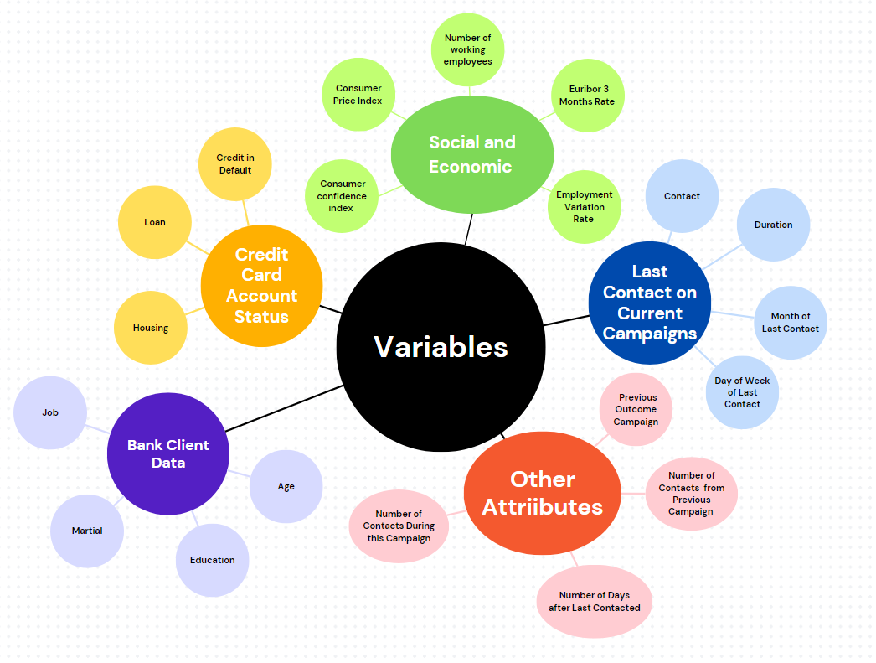
Proposed Solution –variables
Notes:
The variables that were reviewed are visualized here.

Slide 8
Analysis plan – Logistic Regression
Load dataset and check preprocess data
Split data into training and test sets
Train the logistic regression model
Compute the logistic regression model and its accuracy
Exponentiate the coefficient into odd ratios
Compute Accuracy
APPROPRIATENESS: Logistic regression is appropriate because it constrains predictions to the interval [0, 1], making it well-suited for binary classification tasks.
DATA VARIABLES REQUIREMENTS: The output variable is a binary categorical target, while the feature variables consist of a mix of categorical and numerical data.
MEASURE OF CLASSIFICATION ACCURACY:
Pseudo-R Squared: Indicates how well the model of interest fits the data compared to the null model.
Binary Confusion Matrix: Used to evaluate the model’s classification accuracy.
Precision-Recall Curve: Shows the trade-off between different accuracies (precision and recall) for different decision thresholds.
ROC Curve: Validates the model’s classification performance as indicated by the confusion matrix, showing the trade-off between true positive and false positive rates.
Notes:
My analysis plan is to use the three-models mentioned. So, this is the logistic regression process, this is an appropriate model for identifying key predictors and their relationship to customer responses. It requires a binary output, along with categorical and numerical feature variables. Model performance is evaluated using pseudo-R², a confusion matrix, precision-recall curves, and ROC curves.

Slide 9
Analysis plan – decision trees
Load and preprocess the dataset
Specify, estimate and Plot the model
Evaluate model fit accuracy
Explore the model parameters
Tuning model parameters
Retraining tree
Plot variable importance
Partition into training and test sets
APPROPRIATENESS: Decision trees are appropriate as they predict the most likely outcome for each observation in the binary categorical target variable based on the feature variables.
DATA VARIABLES REQUIREMENTS: The output variable is a binary categorical target, while the feature variables are a mix of categorical and numerical data.
MEASURE OF CLASSIFICATION ACCURACY:
Binary Confusion Matrix: Used to evaluate the model’s classification accuracy.
ROC Curve: Used to validate the classification accuracy indicated by the confusion matrix.
Sum of squared error (SSE): Helps compare different tuning parameters to identify the optimal settings for the model.
Notes:
Next one is decision trees and this is the process. Decision trees are useful for visualizing the outcomes of various input conditions. The data requirements are the same as logistic regression. Accuracy is assessed using a confusion matrix, ROC curve, and sum of squared errors.

Slide 10
Analysis plan – BAGGING
Create a random sample of size with replacement
Repeat steps 1-3 by M times to train M Models
Train a classification model using sample dataset
Compute the predicted class via a major vote across the different models
Load and preprocess the dataset
Partition into training and test sets
Computer and Evaluate Test Accuracy of the Bagged Model
APPROPRIATENESS: Decision trees are appropriate for this analysis as they can visually compare and confirm the accuracy of both decision trees and logistic regression models. Bagging significantly enhances model stability by improving accuracy and reducing variance, effectively addressing the challenge of overfitting.
DATA VARIABLES REQUIREMENTS: The output variable is a binary categorical target, and the feature variables consist of a mix of categorical and numerical data. A random sample of size n (where n represents the number of observations in the original dataset) is used.
MEASURE OF CLASSIFICATION ACCURACY:
Sum of squared error: Used to compare the accuracy of the decision tree model.
Binary Confusion Matrix: Used to assess the model’s classification accuracy.
Notes:
The last model is bagging, the process is here. Bagging is appropriate as it stabilizes decision trees by using random samples. Its data requirements are similar to the other models, with the addition of random sampling. Accuracy is measured using the sum of squared errors, and a confusion matrix.

Slide 11
Analysis plan – feature engineering
Certain values were identified as irrelevant in the dataset, which includes:
Customers with the value "unknown" for credit account status, housing, and loan.
Customers with the value "unknown" for job, education, and marital status.
These values were removed to focus on data that reflects the characteristics of customers most likely to subscribe to the program based on campaign efforts.
The dataset is unbalanced, with significantly more "no" responses than "yes," which may be due to biased sampling methods or measurement errors. This imbalance could lead to issues such as overfitting. To address this, the dataset was balanced using a combination of under-sampling and over-sampling of positive and negative cases, ensuring the data remains unbiased while minimising the risk of information loss.
Clear and detailed description of the analysis plan, noting how assumptions will be tested, giving highly specific details for each step of the analysis, and demonstrates how the results will be interpreted.
Notes:
Before analysis, unknown variables were removed to reduce bias and improve data quality. The dataset was also rebalanced through over and under sampling, as there were initially more “no” than "yes" responses, ensuring the models could make unbiased predictions for better results.

Slide 12
Results & Interpretation – Logistic Regression
Variable | Estimate Coeff | Std. Error | Z value | P value | Odd Ratio
age | 8.165e-03 | 1.904e-03 | 4.323 | <0.05 | 1.004709e+00
Job-admin | -3.297e-01 | 9.545e-02 | -3.454 | <0.05 | 7.191151e-01
Job-blue-collar | -2.745e-01 | 6.819e-02 | -4.025 | <0.05 | 7.599706e-01
Job-entrepreneur | -4.739e-01 | 1.362e-01 | -3.479 | <0.05 | 6.225387e-01
Job-housemaid | -4.653e-01 | 1.240e-01 | -3.754 | <0.05 | 6.279600e-01
Job-management | 1.635e-01 | 6.651e-02 | 2.458 | <0.05 | 1.177587e+00
Job-self-employed | -4.783e-01 | 1.282e-01 | -3.731 | <0.05 | 6.198648e-01
Job-services | -2.875e-01 | 6.860e-02 | -4.191 | <0.05 | 7.501330e-01
Education-basic6y | 3.018e-01 | 1.089e-01 | 2.770 | <0.05 | 1.352307e+00
Education-highschool | 1.523e-01 | 7.599e-02 | 2.004 | <0.05 | 1.164513e+00
Education-professionalcourse | 1.769e-01 | 8.126e-02 | 2.177 | <0.05 | 1.193497e+00
Education-universitydegree | 2.371e-01 | 7.629e-02 | 3.108 | <0.05 | 1.267592e+00
Contact-telephone | -4.935e-01 | 6.420e-02 | -7.687 | <0.05 | 6.104714e-01
Month-Aug | 1.723e+00 | 1.254e-01 | 13.741 | <0.05 | 5.603564e+00
Month-dec | 2.153e+00 | 2.370e-01 | 9.086 | <0.05 | 8.611207e+00
Month-jul | 6.466e-01 | 1.121e-01 | 5.767 | <0.05 | 1.909010e+00
Month-jun | 6.101e-01 | 9.957e-02 | 6.128 | <0.05 | 1.840679e+00
Month-mar | 3.066e+00 | 1.799e-01 | 17.049 | <0.05 | 2.146380e+01
Month-may | 1.920e-01 | 6.357e-02 | 3.021 | <0.05 | 1.211710e+00
Month-nov | 2.230e+00 | 2.344e-01 | 9.514 | <0.05 | 9.301582e+00
Month-oct | 3.205e+00 | 2.813e-01 | 11.393 | <0.05 | 2.466127e+01
Month-sep | 3.574e+00 | 3.060e-01 | 11.680 | <0.05 | 3.567082e+01
Day_of_week-mon | -1.826e-01 | 5.097e-02 | -3.582 | <0.05 | 8.331289e-01
Day_of_week-tue | 1.255e-01 | 5.117e-02 | 2.452 | <0.05 | 1.133667e+00
Day_of_week-wed | 2.111e-01 | 5.199e-02 | 4.061 | <0.05 | 1.235084e+00
Day_of_week-thu | 1.051e-01 | 4.985e-02 | 2.108 | <0.05 | 1.110780e+00
Duration | 5.409e-03 | 8.999e-05 | 60.113 | <0.05 | 1.005424e+00
campagin | -9.367e-02 | 1.289e-02 | -8.882 | <0.05 | 8.918503e-01
pdays | -1.013e-03 | 8.819e-05 | -11.484 | <0.05 | 9.989877e-01
previous | -6.755e-02 | 2.5583-02 | -2.641 | <0.05 | 9.346765e-01
Poutcome-sucess | 9.369e-01 | 8.659e-02 | 10.820 | <0.05 | 2.552163e+00
Emp_var_rate | -2.122e+00 | 1.247e-01 | -17.024 | <0.05 | 1.197537e-01
Consumer price index | 5.932e+00 | 3.892e-01 | 15.241 | <0.05 | 3.768016e+02
Consumer confidence index | 1.591e-01 | 9.904e-03 | 16.062 | <0.05 | 1.172437e+00
euribor3m | -3.224e+00 | 3.079e-01 | -10.469 | <0.05 | 3.644031e-02
Nr_employed | 7.648e-02 | 6.531e-03 | 11.711 | <0.05 | 1.079485e+00
Older customers are more likely to subscribe to the programs, implying that they understand the benefits of the programs based on the campaigns.
Customers in jobs such as admin, blue-collar work, entrepreneurship, housemaids, self-employment, and services are less likely to subscribe, whereas those in management are more likely to subscribe. This pattern could be caused by the campaigns are targeted toward these customers, or those customers are naturally more inclined to subscribe.
Customers with education levels such as high school, professional courses, or university degrees are approximately 1.1 times more likely to subscribe. While customers with only basic education (up to six years) are about 1.35 times less likely to subscribe. This indicates that either the campaigns and programs are directed toward more educated customers, or these customers are naturally more receptive to the programs.
Customers contacted via telephone are 6.1 times less likely to subscribe compared to customers contacted via cellular. This potentially indicating that campaigns promoted through telephone users are less effective, or that these programs are not as appealing to telephone users.
Customers who have subscribed to previous campaigns are 2.55 times more likely to subscribe again, this could indicate that the programs offer value to the subscribed customers. Considering the similarities between the past and current campaigns, could help refine future marketing efforts.
While the day of the week or the month of the last contact doesn’t directly influence subscription likelihood, certain months do. For example, customers are 5.6 times more likely to subscribe in months like May compared to April, suggesting a potential seasonal advantage. The marketing team should analyse whether there are seasonal trends in the campaigns or programs that attract customers.
Longer call durations also increase the likelihood of subscription, with higher engagement during calls indicating high-value customers.
Several factors during the campaign—such as the number of contacts made during previous campaigns (poutcome), the number of days since the last contact (pdays), and the number of prior contacts—reduce the likelihood of customers subscribing, by an estimated factor of 9. This suggests that customers contacted too frequently may experience fatigue.
Economic variables such as the consumer price index (CPI), consumer confidence index, and the number of working employees positively impact subscription rates. The model highlights that when the CPI rises, customers are 3.77 times more likely to subscribe.
Conversely, as the Euribor 3-month rate and the employment variable rate increase, customers become less likely to subscribe. This suggests that campaigns should be timed when these rates are lower, as customers are 3.64 times more likely to subscribe when the Euribor rate is low.
The high-value customers that the marketing team should target include older individuals, those working in management, and those with high school, professional, or university-level education. Customers fitting this profile are more likely to subscribe, as confirmed by the logistic regression model. Additionally, insights from previous and current campaigns should be considered when identifying high-value customers. Furthermore, monitoring economic conditions and launching campaigns during favourable economic periods will maximise the likelihood of success.
Notes:
The logistic regression model identified several patterns. The High-value customers that the marketing team should target include older individuals, those in management, and those with high school, professional, or university education. Because the model suggests customers with these characteristics are more likely to subscribe to term deposits programs.

Slide 13
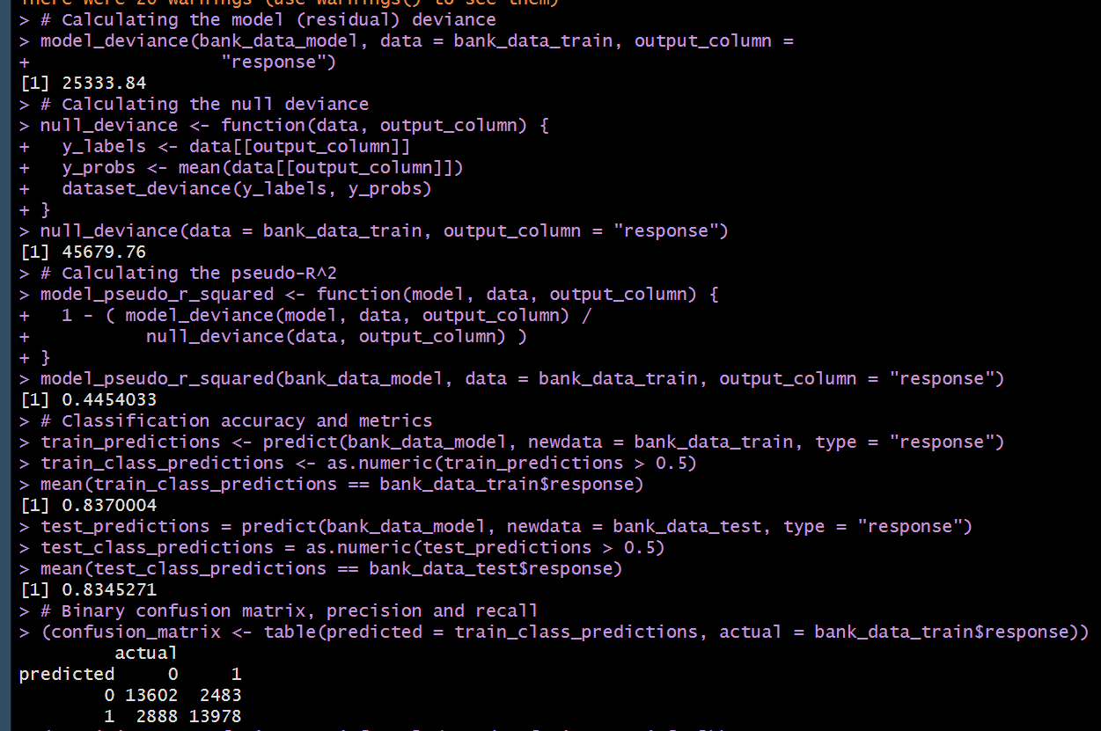
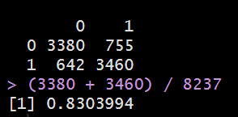
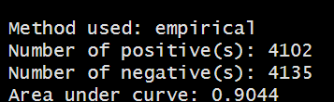
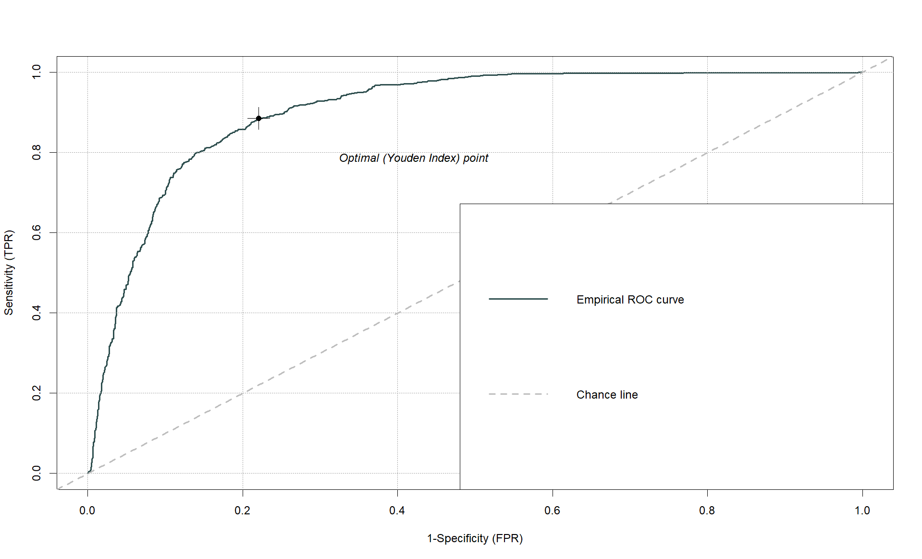
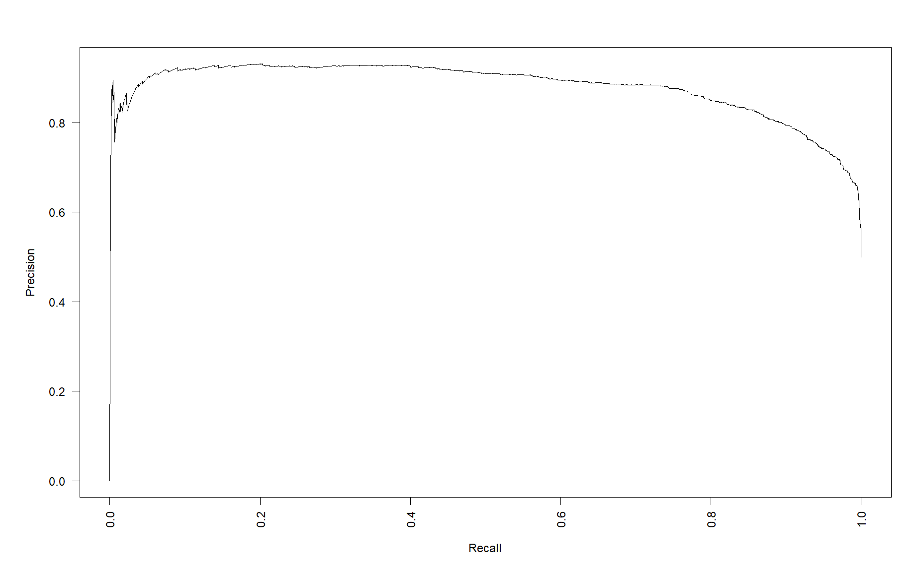
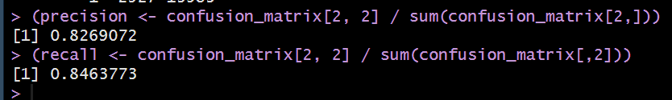
Results & Interpretation – Logistic regression accuracy
Interpretations:
The deviance and null deviance are quite large, as reflected in the pseudo-R² value of 44.54%. This indicates that the model is only moderately successful in improving the fit compared to the null model, suggesting marginal performance.
Despite this, the logistic regression model achieved an accuracy of around 83% on both the training and test datasets. The confusion matrix for the test dataset shows the model performed well, as its accuracy exceeds 80%.
The precision-recall curve demonstrates that precision and recall remain between 80% and 85%. A precision above 80% indicates that the model effectively predicts positive cases. Similarly, a recall above 80% suggests that the model is successful in identifying most of the positive cases within the dataset. Any further deviation could compromise the model’s performance.
The ROC curve, with an area under the curve (AUC) of 0.90, shows that the model discriminates excellently between positive and negative instances across various classification thresholds, reflecting strong performance in distinguishing between the two classes.
Method used: Empirical
Number of positive:4102
Number of negatives: 4135
Area under the curve: 0.9044
Deviance: 25333.84
Null deviance: 45679.76
R squared: 44.54%
Train accuracy: 83.7%
Test accuracy: 83.45%
Precision: 82.69%
Recall: 84.63%
Test Data | Actual
Predicted | 0 | 1
0 | 3380 | 755
1 | 642 | 3460
Test accuracy: 83.45%
Notes:
The model achieved an accuracy of around 83%, in addition, precision and recall accuracy both above 80%, indicating the patterns are reliable and should be considered when developing new marketing strategies.

Slide 14
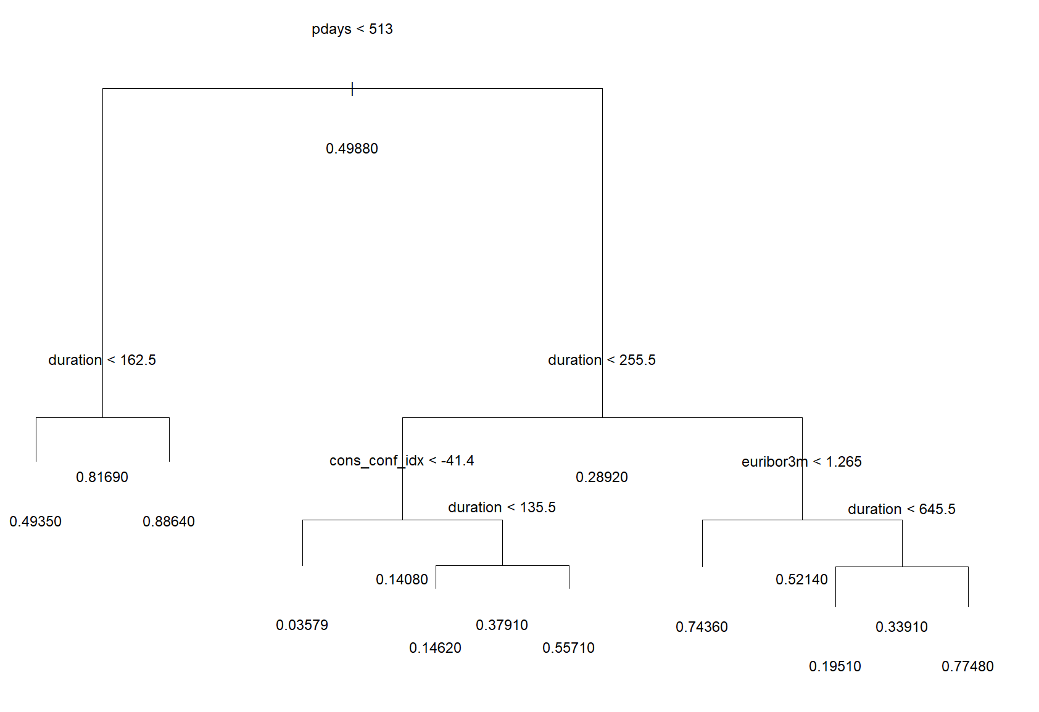
Results & interpretation – Decision tree
Results:
Initially, the likelihood of a customer responding "yes" or "no" is about 50:50, with a slight lean towards "no.“
If a customer has been contacted within 513 days and the call duration exceeds 162.5 seconds, they are more likely to respond "yes." Otherwise, the response is slightly more likely to be "no.“
Customers are significantly more likely to respond "no" if they were last contacted over 513 days ago, the call duration was under 255.5 seconds, and the consumer confidence index was below -41.4. However, if the call duration exceeds 135.5 seconds in this case, the response is more likely to be "yes," though it still leans towards "no" otherwise.
Customers are significantly more likely to respond "yes" if they were contacted more than 513 days ago, the call duration was over 255.5 seconds, and the Euribor 3-month rate was below 1.265.
Similarly, customers are more likely to respond "yes" if contacted over 513 days ago, with a call duration exceeding 255.5 seconds, the Euribor rate is above 1.265, and the duration exceeds 645.5 seconds. Otherwise, a "no" response is strongly expected.
Interpretation:
The key features in this decision tree are the number of days since the last contact (pdays), call duration, consumer confidence index, and Euribor 3-month rate. To increase the likelihood of positive responses, the tree suggests that the marketing team should closely monitor these variables within the indicated ranges.
Notes:
The decision trees model highlighted call duration, days since last contact, and economic factors such as the Euribor 3-month rate and consumer confidence index as key predictors. Customers contacted before 513 days and those with longer call durations were more likely to subscribe.

Slide 15
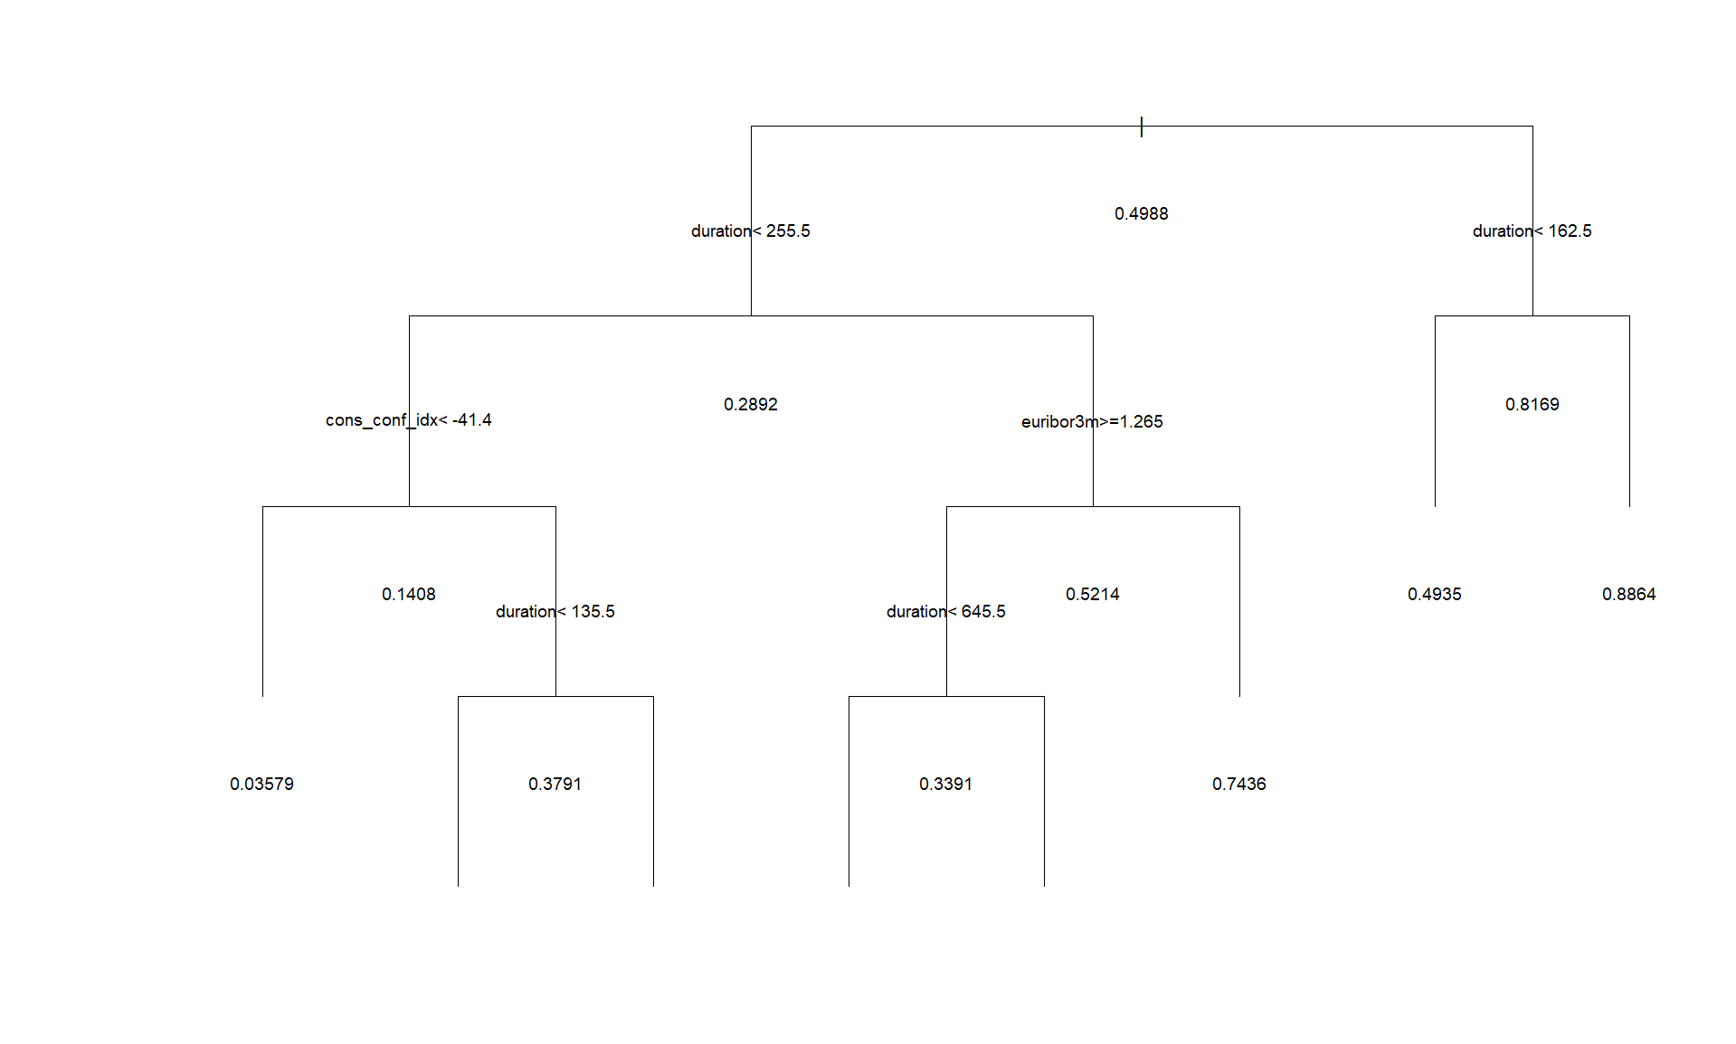
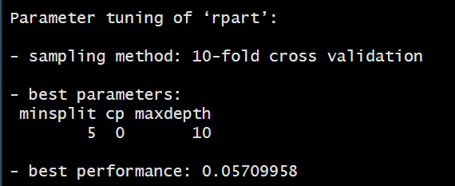
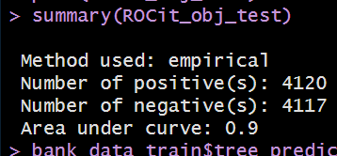
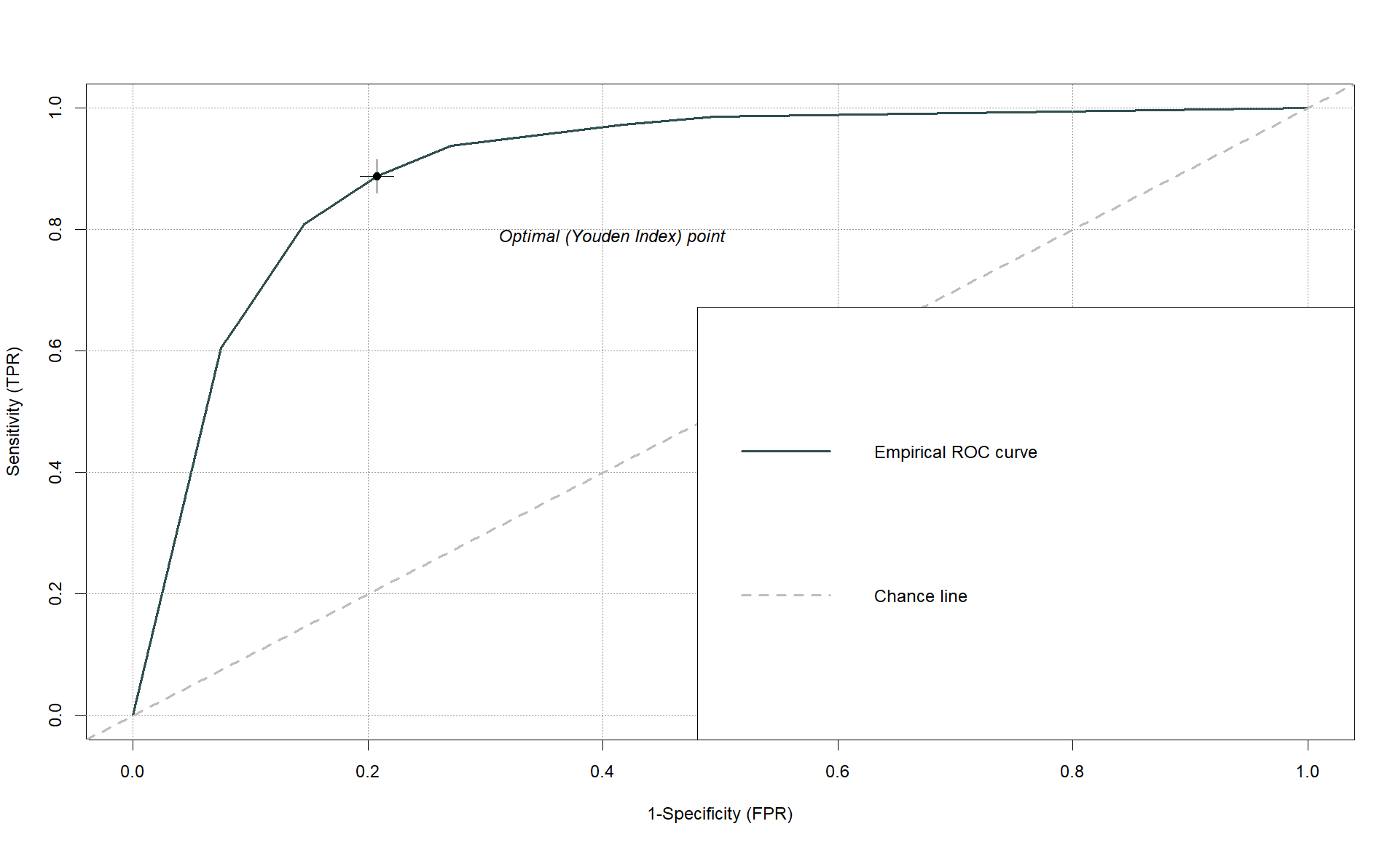
Results & Interpretation Decision trees (CART/rpart)
Another decision tree was generated to further confirm that the identified variables were influencing customer decisions.
The RPART function produced a similar tree to the previous one, so no new insights were gained from this iteration.
The model's fit to the test data resulted in a sum of squared errors (SSE) of 1029.955.
A 10-fold cross-validation was performed to determine the optimal parameters for tuning the RPART model. The best parameters were a minimum of 5 splits, a complexity parameter (cp) of 0, and a maximum depth of 10. This tuning resulted in an improved performance score of 0.0571.
After retraining, the tree’s SSE was reduced to 435.7078.
The decision tree achieved an accuracy of approximately 83% on both the training and test datasets, as shown by the confusion matrix. This suggests the model performed well in classifying outcomes.
The ROC curve yielded an area under the curve (AUC) of 0.90, indicating that the model successfully discriminated between positive and negative instances across different classification thresholds.
Test Data | Actual
Predicted | 0 | 1
0 | 3261 | 856
1 | 465 | 3655
Accuracy of test data: 83.96%
Method used: Empirical
Number of positive:4120
Number of negatives: 4117
Area under the curve: 0.9
Notes:
A second decision tree was built to assess the previous tree, which produced similar insights about high-value customers.
The model also achieved an 83% accuracy on test data. This accuracy suggests using bagging to compare against this model and the logistic regression would gains deeper insights.

Slide 16
Results and Interpretation – Bagged tree
Interpretation:
The bagged tree model achieved an accuracy of 0.0379, indicating that the model is highly accurate. This performance surpasses that of the decision tree model, which had an accuracy of 0.0571. As a result, the bagging model should be compared to the logistic regression model for further evaluation.
Both the training and test datasets showed an accuracy of approximately 83%, indicating that the model generalises well.
The confusion matrix using the test dataset produced an outstanding accuracy of 99.87%, confirming that the model performed exceptionally well in classifying the test data.
The out-of-bag accuracy, which measures the model's performance on unseen data, was also around 83%, closely matching the accuracy of the train and test datasets. This consistency further confirms the reliability of the bagged model.
Although the decision tree model and logistic regression were less accurate than the bagging model, all models demonstrated an accuracy of over 80%, highlighting their effectiveness in predicting customer responses. The high accuracy across the models suggests they have provided valuable insights, and all models results should be considered.
Results
Using the tuned parameters as before, minsplit 50, cp 0, and 150 number of bags
Out-of-bag estimate of root mean squared error: 0.0379
Test increased number of bagged iterations up to 300, did not significantly improve the performance of the bagged tree performed 300-900: 0.0376
Sums of squared error: ~13.45
Train dataset accuracy: 83.80%
Test dataset accuracy: 83.48%
Out of bagged accuracy: 83.68%
Test Data | Actual
Predicted | 0 | 1
0 | 4105 | 10
1 | 0 | 4122
Accuracy of test data: 99.87%
Notes:
Bagging achieved an accuracy of 83.48% on the test data, indicating strong performance. The confusion matrix showed 99.87% accuracy, significantly higher than previous models. This improvement is due to bagging reducing variance in the data. The accuracy indicates that the results from each model should be considered when developing new campaign strategies.

Slide 17
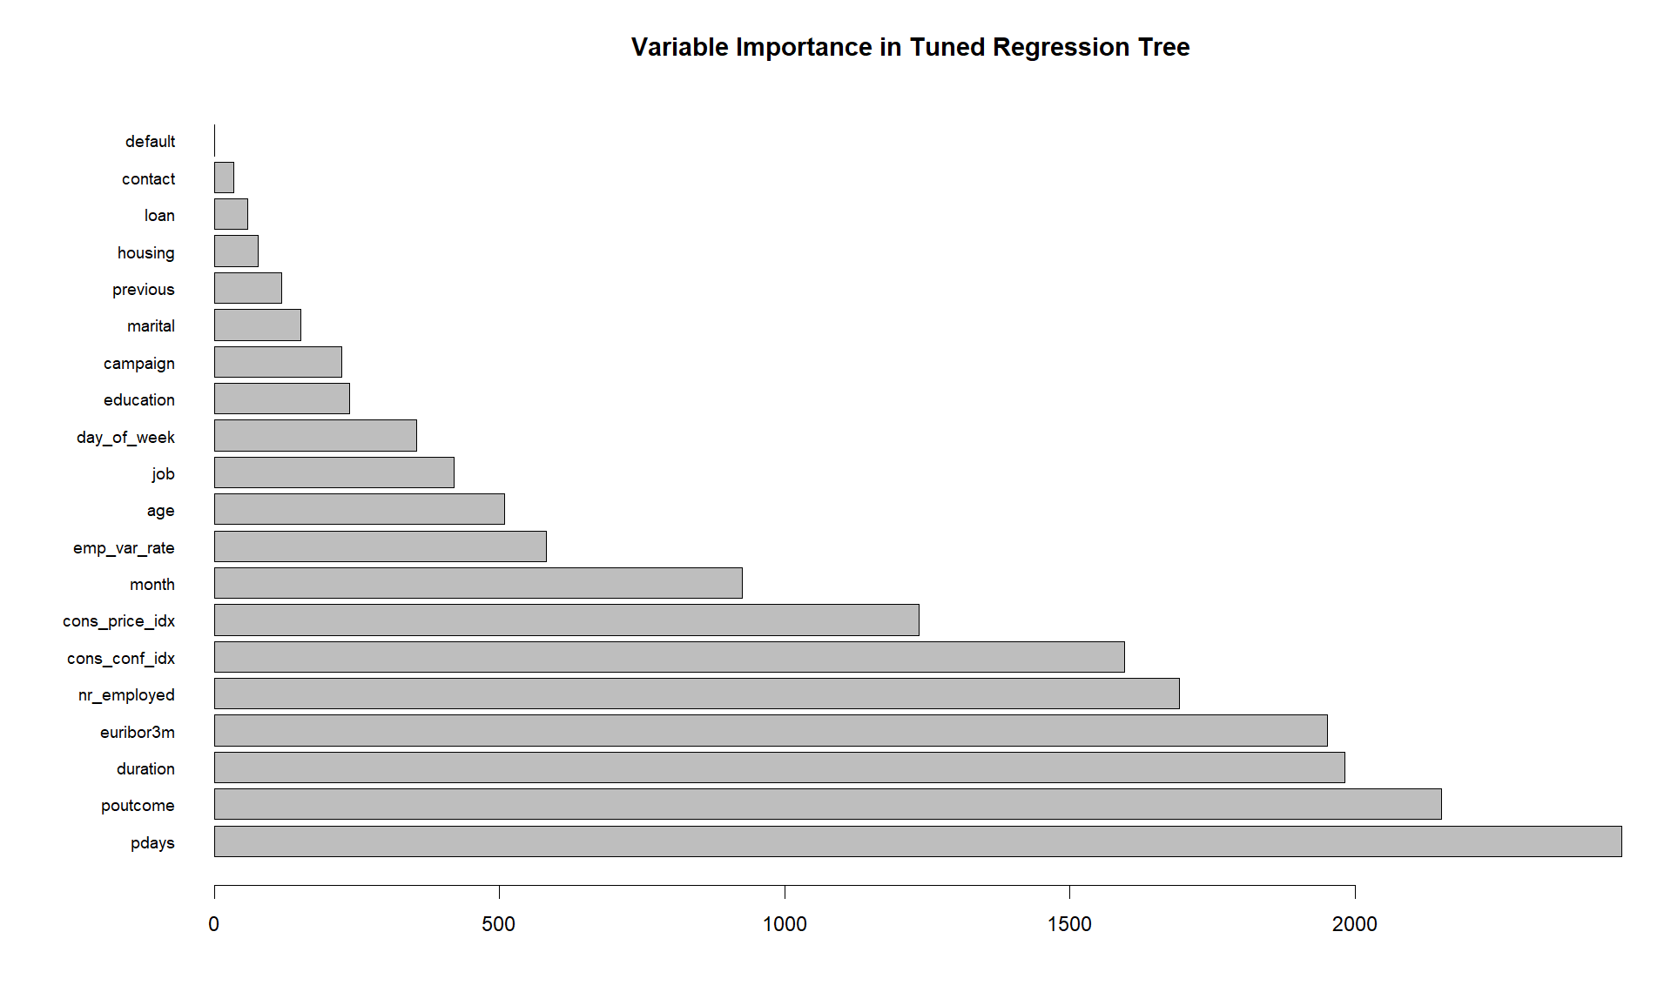
Results & Interpretation – variable importance in Decision Trees
Results:
The top 5 most important variables in the tuned regression tree are as follows: the number of days since the last contact during the campaign (pdays), whether the customer subscribed to the previous campaign (poutcome), the duration of the customer’s last call during the campaign, the Euribor 3-month rate, and the consumer confidence index.
From the plot, it is evident that the economic variables played a significant role. These include the Euribor 3-month rate (euribor3m), the number of working employees (nr_employed), the consumer confidence index (cons_conf_index), the consumer price index (cons_price_index), and the employment variation rate (emp_var_rate).
Interpretation:
The variables about the customer’s last contact during a campaign were deemed important because they help identify which customers were more engaged during the campaign. Highly engaged customers are more likely to subscribe to programs.
The economic variables also have considered to have a significant relation to subscribing to campaigns, due to favorable economic conditions may have increase the likelihood of customers subscribing to programs.
Notes:
Across all models, the most significant variables were information about customers' last contact during campaign and economic factors, both strongly influencing a customer to open an account. This could be due to customers having favorable economic conditions or high engagement during the campaign may have increased the chances of them subscribing.

Slide 18
Strategy
The results have revealed several unique patterns that influence customer subscriptions to programs. These insights are invaluable for the marketing team to develop strategies that target high-value customers, ensuring more subscriptions from campaigns while minimising costs and labour.
The insights of the key attributes of high-value customers for the marketing team to note:
Customers who are older, work in management, and have a high school education, professional certification, or university degree are more likely to subscribe.
Customers who are younger, work in admin, blue-collar jobs, as entrepreneurs, housemaids, self-employed, or in services, and have only a basic six-year education, are less likely to subscribe.
Customers are more likely to subscribe when the consumer confidence index is above -41.4 and the Euribor 3-month rate is below 1.26.
A customer is significantly more likely to subscribe if their interaction duration from the last contact exceeds 162.4 seconds.
Other key attributes of high-value customers include fewer days since the last contact (pdays), a higher number of contracts from both current and previous campaigns, and whether they subscribed to the previous campaign.
These characteristics define the high-value customers most likely to subscribe, so the marketing team should prioritise strategies targeting these insights for future campaigns. To maximise the effectiveness of this data, the team can take several steps:
Create programs related to the high-value customer’s characteristics
Design campaigns that specifically attracts high-value customers
Launch campaigns when the customers' economic indicators, such as the consumer confidence index and Euribor rate, fall within the optimal range mentioned above.
Notes:
In conclusion, the analysis revealed high value customers are older customers, work in management and those with higher education were more likely to subscribe. When economic factors and information on customers’ last contact are in specific ranges, they are also attributes in high value customers.
Based on these insights, the marketing team should improve their campaigns by creating programs tailored to high-value customer traits, designing campaigns that attract these customers, or launching campaigns when economic conditions are favourable.

Slide 19
Recommendations
Three recommendations were suggested for the marketing team’s next project:
Complete the development of programs targeted at high-value customers and begin advertising them immediately.
Only promote programs and campaigns (from prior projects) to customers whose current economic indicators fall within the ideal range.
Ensure all three key steps are finalised before launching the next campaign.
The potential costs associated with these recommendations include increased expenses, longer timelines, and higher labour demands.
As a result, the most and least feasible recommendations have been identified for the marketing team to consider:
Most Feasible Recommendation: Release the programs already developed for customers likely to subscribe, based on their characteristics. This approach is more practical because the effectiveness of these strategies is still unknown. By rolling out this initial step and gathering data, the marketing team can implement the most effective strategies and make adjustments as needed. If the data reveals that the strategies are ineffective, the team can refine them before designing campaigns specifically targeting high-value customers.
Least Feasible Recommendation: Implement all strategies at once for the next campaign. This option is less feasible due to the significant costs, time, and labour involved. Additionally, it is uncertain when the campaign can be launched, as it depends on unpredictable factors like when customers’ economic indicators reach the desired range.
Notes:
These strategies can be costly, and resource-intensive. Therefore, my main recommendations are to:
Develop targeted programs towards high-value customers and launch them immediately.
Launch campaigns toward customer when their economic conditions are favorable
Or the least feasible recommendation is to Implement all strategies simultaneously.
The drawbacks include higher costs, longer timelines, and increased resources. Therefore, I recommend starting with the first option—launching targeted programs—because it allows for quicker feedback and adjustments with the minimal resources and time commited. The last option should be carefully considered, as economic conditions are unpredictable, making it uncertain when the next campaign can be launched.

Slide 20
Future research
After completing the next campaign with the recommended strategies, the next project should involve analysing the updated bank data and comparing it with this dataset to assess the effectiveness of the implemented strategies.
To note on the bagging model results, it is recommended to explore other ensemble methods to improve the quality of the analysis. If additional time, data, and resources are available, applying other binary classifiers could provide deeper insights or reveal new patterns. These classifiers could include Random Forest models, Support Vector Machines, K-Nearest Neighbours, Naïve Bayes, and Neural Networks, all of which might enhance the investigation and uncover further opportunities for improvement.
Notes:
For future research, the next project should compare bank data before and after implementing these strategies to evaluate their effectiveness.
Given the strong performance of bagging, further exploration of more advanced methods such as random forests model or support vectors models should be considered, because they could improve model performance and provide deeper insights if more time and resources are given.
And that concludes the presentation. Thank you for listening!

